Slide 1
YouTube Case Study
Rohit Rai
Comprehensive analysis of YouTube comments and user engagement

Slide 2
Overview
This report covers a comprehensive analysis of YouTube comments data, including sentiment analysis, emoji analysis, and exploratory data analysis (EDA). The project aims to provide insights into user sentiment, common topics in positive and negative comments, emoji usage, and engagement metrics. The analysis also includes the examination of categorical data, punctuations in titles, and channels with the most trending videos.

Slide 3
Approach
Data Loading and Cleaning
Sentiment Analysis
Wordcloud Analysis
Emoji Analysis
5. Category Analysis
6. Audience Engagement
7. Channels with Most Trending Videos
8. Punctuation Analysis

Slide 4
Background & Objective
YouTube has become one of the largest platforms for content creators to share their videos and engage with audiences worldwide. With millions of videos uploaded every day and billions of users engaging with the platform, understanding user sentiments, engagement metrics, and content trends is essential for content creators and marketers to optimize their strategies.
The objective of this project is to conduct a comprehensive analysis of YouTube comments and user engagement metrics to provide insights for content creators and marketers. This analysis will involve sentiment analysis of comments, exploration of emoji usage, identification of trending topics, analysis of engagement metrics, and examination of key factors influencing audience engagement.

Slide 5
Let’s Start
First we are import some basic Libraries,
Like as Pandas, Numpy, Matplotlib.pyplot, Seaborn etc
import pandas as pd
import numpy as np
import matplotlib.pyplot as plt
import seaborn as sns

Slide 6
Data Loading
Description of data loading process
Ex:- comments = pd.read_csv('UScomments.csv', on_bad_lines='skip’)
Handling missing values

Slide 7
Performing Sentiment Analysis
1. Explanation of sentiment analysis using TextBlob
2. Visualization of sentiment distribution

Slide 8
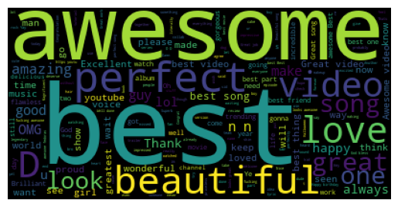
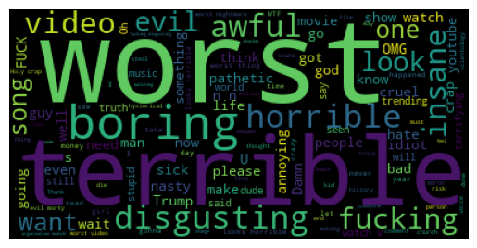
Perform Wordcloud Analysis
Key insights from word clouds
Positive comments word cloud Negative comments word cloud

Slide 9
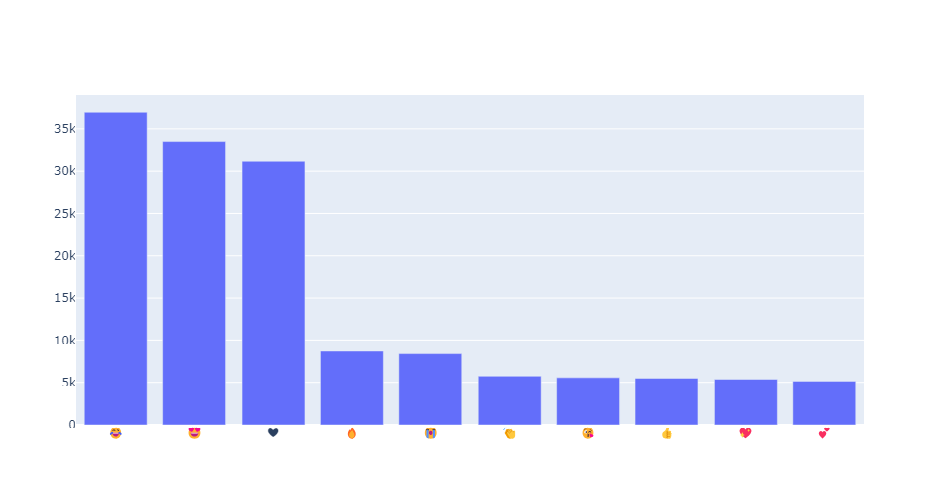
Perform Emoji Analysis
Process of extracting and analyzing emojis
Top 10 emojis and their frequencies
Insights from emoji analysis

Slide 10
Data Collection & Export
Combining additional data files
Exporting cleaned data to CSV, JSON, and SQLite

Slide 11
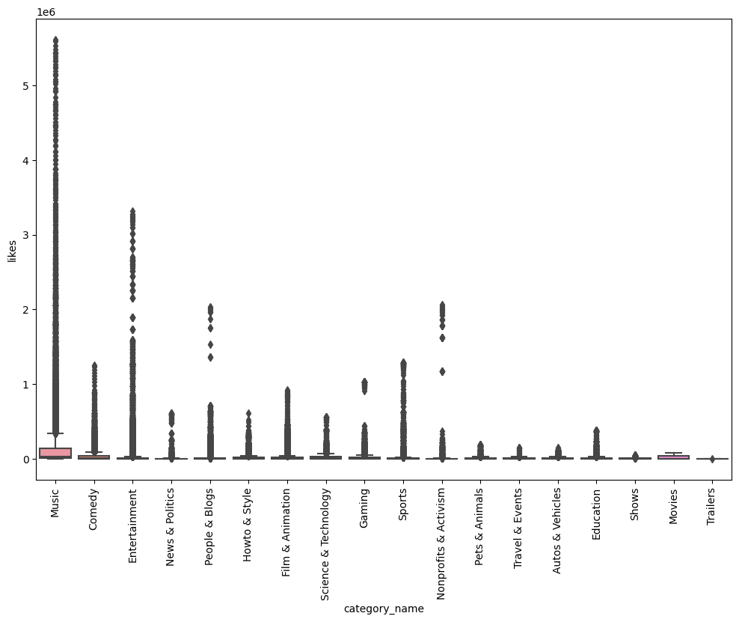
Analysing The Most Liked Category
Analyzing which category has the most likes
Visualization using boxplot
Key findings

Slide 12
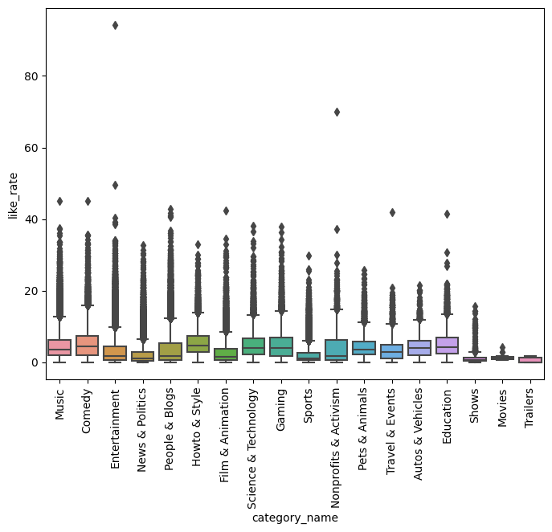
Analyse Whether Audience Is Engaged Or Not
Calculating like rate, dislike rate, and comment rate
Visualizations of engagement metrics
Insights on audience engagement

Slide 13
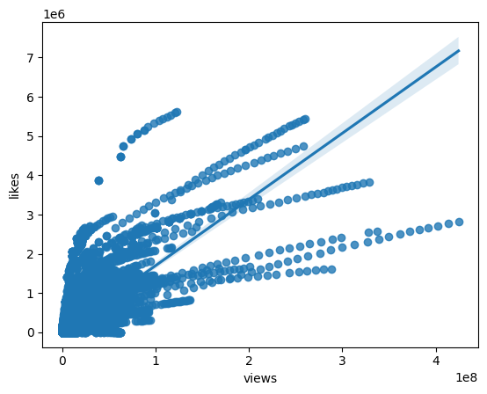
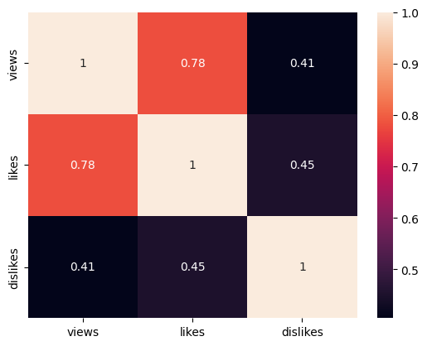
Conti…

Slide 14
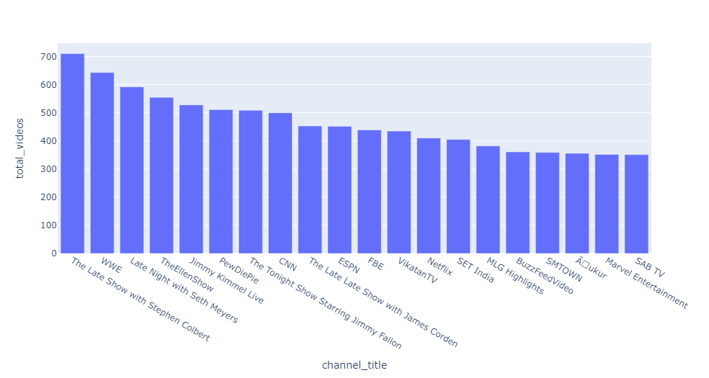
Analyzing trending videos of YouTube
Identifying top channels by number of trending videos
Visualization using bar chart
Key findings

Slide 15
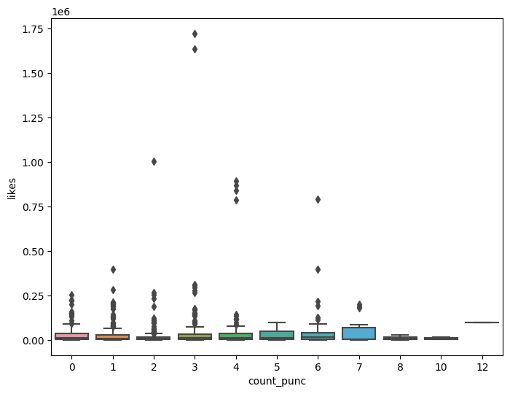
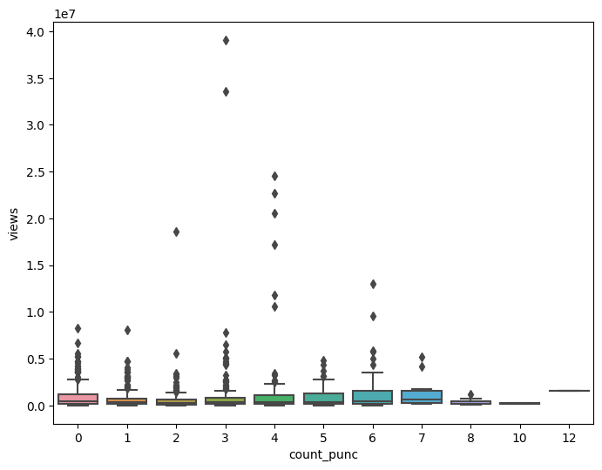
Punctuation Have An Impact On Views, Likes, Dislikes
Analyzing the impact of punctuations in titles on views and likes
Visualizations using boxplots

Slide 16
Conclusion
This analysis provides valuable insights into user sentiments, emoji usage, engagement metrics, and trending content on YouTube. The findings can help content creators understand their audience better and improve their content strategies.

Slide 17
Thank You

